Slide 1
EVRC Python Course Training 5: Version Control and Co-operative Development (git)
Aaron Rabinowitz, Vaishnavi Karanam

Slide 2
Section 0: Syllabus

Slide 3
Syllabus - Learning Objectives
Programming in Python:
Programming fundamentals
Python object structure and flow control
Data manipulation in Python
Leveraging Python site-packages
Run-time optimization
Programming Workflow:
Finding a development environment that works for you
Writing code others can use
Using the internet as a resource
Version control

Slide 4
Syllabus - Course Outline
Trainings:
What is Python? Background and Basic Module Structure (Aaron)
Data Types Deep Dive (Aaron)
CodeMari: Basic hacks to reduce coding chaos (Vaish)
Pandas and Beyond (Vaish)
Speeding up Code (Aaron, Vaish)
Version Control (Aaron)
Using Databases with Python (Vaish, maybe Kai)
Critical Internet-ing (TBD)
Advanced Topics at Request (TBD)

Slide 5
Section 0: Installing Git

Slide 6
Installing Git - Instructions
https://git-scm.com/book/en/v2/Getting-Started-Installing-Git - (Google: installation git)
If you are using Windows make sure that you managed to install Git bash.
If you are using Linux or Mac Git may (should) already be installed. Open up a terminal instance and type “git --version” to test this.

Slide 7
Configuring Git - Globals
Type the following commands substituing the appropriate information between the < >
git config --global user.name “<your name>”
git config --global user.email “<your email>” - this should be an email that is or will be associated with your github account.

Slide 8
Section 1: Version Control

Slide 9
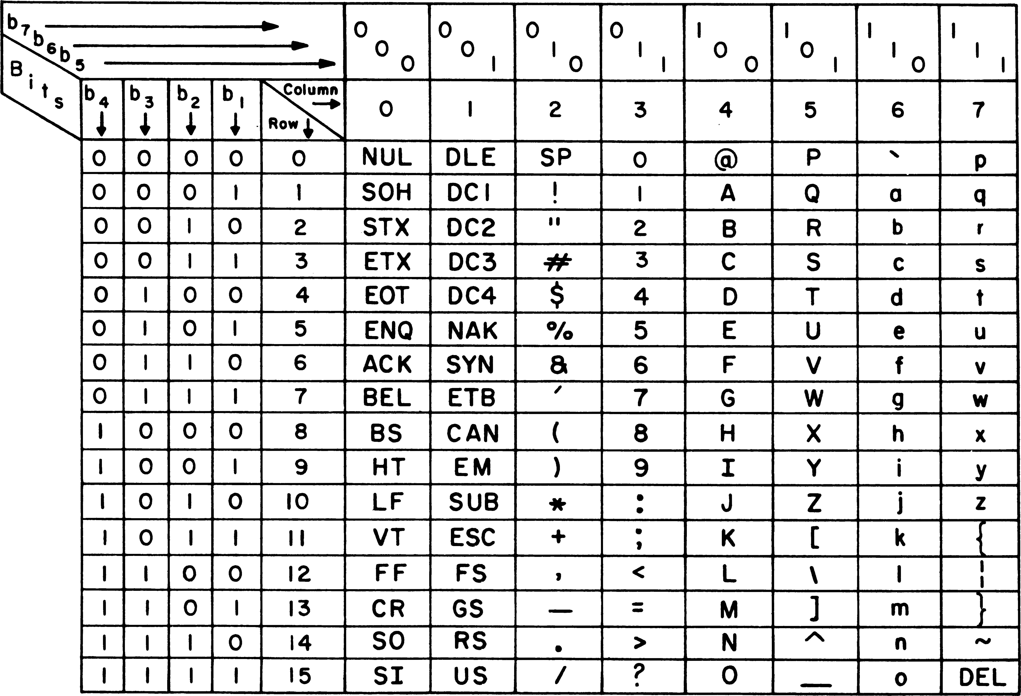
Version Control - Input Files
The most iportant thing to remember with version control is that all “input” files are really just ASCII text.
File extensions (name.extension e.g. Lecture.pptx) are for human readibility, and programmatic format identification - the computer does not really need that information.
You can run Python on “Hello.py” or “Hello.txt” or “Hello” as long as the code contained is valid Python code.
Input files are every file that you run a program on:
.docx, .pptx, .py, .html, .xml, .zip, etc.
Again - literally every single one of these is actually an ASCII text file.
https://en.wikipedia.org/wiki/ASCII#/media/File:USASCII_code_chart.png

Slide 10
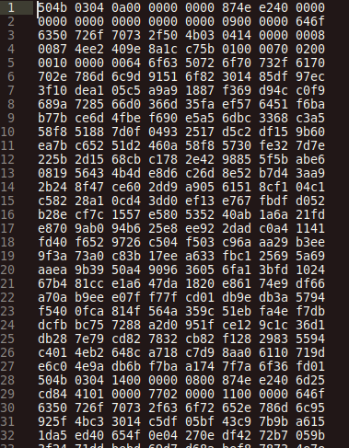
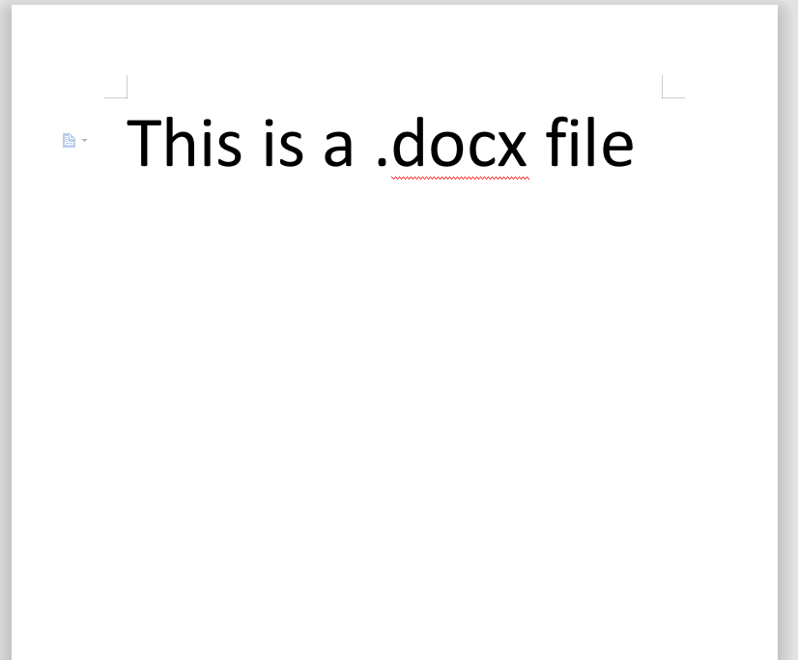
Version Control - Input Files
What it looks like in Word
What it looks like in a text editor

Slide 11
Version Control - Tracking Changes
Because all input files are essentially the same - a single program can track changes for all types. This is what git does.
The central theory behind git is that the state of a document at any time can be reconstructed by applying or reversing changes
Corrolary: In order to be able to reconstruct any document state one needs only to track the changes
A git repository is any directory containing a .git sub-directory
The .git sub-directory stores compressed information on the changes including meta-data on:
Order of changes (previous version)
Originator of changes
Timestamp of changes

Slide 12
Version Control - Branching Graphs
Tree Graph
River Graph
Branch
Merge

Slide 13
Practicum: Local Git Repository

Slide 14
Practicum - Local Git Repository
Create a folder in your Desktop directory named “LocalRepositoryExample”
Using terminal (Linux/Mac) or Git Bash (Windows) navigate to that folder
Command line navigation for all options uses bash commands. The ones that you need to remember for now are:
cd - change directory:
to change to a subfolder - cd ./<subfolder> or cd <subfolder>
to change to the folder containing the current folder - cd ../
to change to user home folder - cd ~
ls - list items in directory:
to list items in current folder - ls
to list idems in subfolder - ls ./<subfolder> or ls <subfolder>
pwd - return current folder path
Once in the LocalRepositoryExample folder initialize a git repository by running “git init”
Now run “ls -a” you should see “. .. .git”

Slide 15
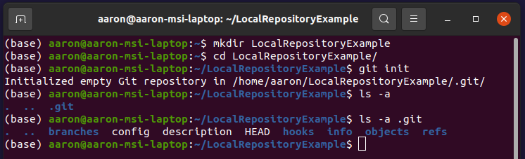
Practicum - Local Git Repository
You have created a git repository - it contains ...
objects - where the references for the changes will be stored
HEAD - the currently active branch
There must always be a current branch - by default this is the “master” branch for local repositories but was changed to the “main” branch for github and gitlab initialized repositories in 2020 thus ending racial strife and ushering in the utopic era of tolerance we live in today. The only drawback is that locally created repositories still have a “master” branch which can cause confusion
Everything else - https://git-scm.com/docs/gitrepository-layout or https://developernation.net/blog/git-internals-list-of-basic-concepts-that-power-your-git-directory

Slide 16
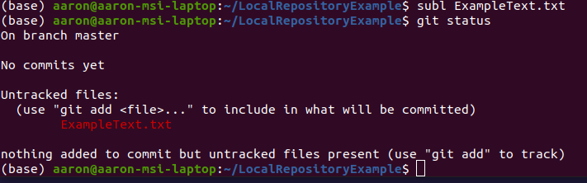
Practicum - Local Git Repository
Open a text editor and save a file called “ExampleText.txt” to your LocalRepositoryExample folder
Now run “git status”
Git automatically noticed that a file was created but hasn’t started tracking changes for that file - this means that when we create a version of the repository (by committing changes) this file won’t be reconstructible in that version

Slide 17
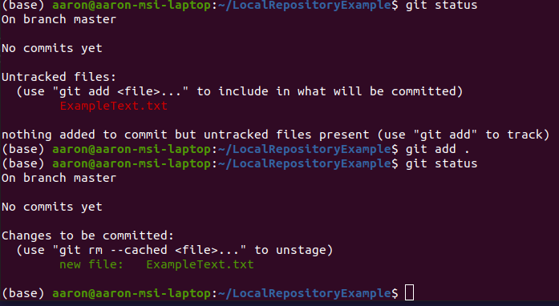
Practicum - Local Git Repository
In order to make git track the new changes (the file) - and thus include it in the next commit (read: repository version)
Now run “git add ExampleText.txt” or, if you want to add all new files in the repository run “git add .” - you will almost always do the latter

Slide 18
Practicum - Local Git Repository
Now that the file is added, let’s make a commit. This will store the changes made so far in the master/main branch so that we can return to this version later
Run the command:
“git commit -m “<your name> <today’s date> <commit number>: First””
Commits, by default, need a message - I prefer to be very descriptive. The commit metadata contains the user.name, date, and time but I prefer to add this to the commit message as well because this puts it all in the same place and makes debugging merge conflicts easier.
Following that - run git status again

Slide 19
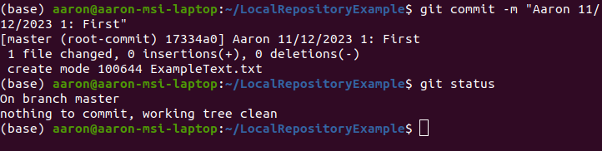
Practicum - Local Git Repository
Now that the file is added, let’s make a commit. This will store the changes made so far in the master/main branch so that we can return to this version later
Run the command:
“git commit -m “<your name> <today’s date> <commit number>: First””
Commits, by default, need a message - I prefer to be very descriptive. The commit metadata contains the user.name, date, and time but I prefer to add this to the commit message as well because this puts it all in the same place and makes debugging merge conflicts easier.

Slide 20
Practicum - Local Git Repository
Now, let’s make some more versions
Make and commit, in sequence, the following changes as separate commits
In the first line of ExampleText.txt type “This line was added in version 1”
Add and commit changes
In the second line of ExampleText.txt type “This line was added in version 2”
Add and commit changes
In the second line of ExampleText.txt type “This line was added in version 3” - do this by moving the line from step 2 to the third line
Add and commit changes

Slide 21
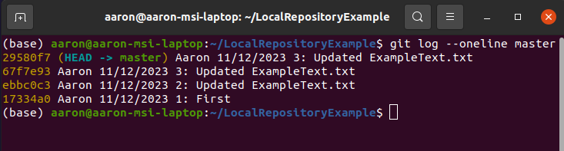
Practicum - Local Git Repository
We may want to go back to a previous version of the repository at some point.
We can check previous commits on a given branch using the git log command
Before we do that - let’s talk branching and merging

Slide 22
Section 2: Branches and Merges

Slide 23
Branches and Merges - Branches
Branches allow for diverging changes to be made
Allows for different versions of the repository to exist with a common ancestor
Branches are very useful because they allow for simultaneous development
In general: developers should work on separate branches which can, later, be merged back into the master/main
N branches of a repository have at least one commit which is common to all and at least N-1 commits which are unique to a branch
River Graph
Branch
Merge

Slide 24
Branches and Merges - Roll-Back
A roll-back operation removes committed changes in order to reconstruct a previous version of the repository
There are two ways that git does this:
git reset - Having stored the changes, git can simply subtract them
git revert - The stored changes are subtracted from the current version and then committed - this creates a new version which looks like an old version but preserves history
If you reset, then you have to roll-forward to get back to current, if you revert you can just roll-back one commit. Reversion is generally the better option.

Slide 25
Branches and Merges - Merges
Merging branches involves comparing the changes present in the branches then applying the uncommon changes in order to get to one common version
It is very important to note that branches are merged onto other branches
Specifically, the named branch is merged onto the active branch - this means that the changes applied are those found in the merged branch which are not found in the active branch
Depending on which branch is the active branch, merging two branches can produce different results
River Graph
Branch
Merge

Slide 26
Branches and Merges - Rebases
When divergent branches are merged, their histories can start to get very different
Branch 1: C0 -> C1 -> C2 -> C4
Branch 2: C0 -> C1 -> C2 -> C3 -> C5
Branch 1 merge Branch 2 gives: C0 -> C1 -> C2 -> C4 -> C3 -> C5
Branch 2 merge Branch 1 gives: C0 -> C1 -> C2 -> C3 -> C5 -> C4
These may result in the same thing but the logs will be different and this can create problems down the line
A rebase is a type of merge that reverts to a common ancestor before replaying changes in order such that both branch histories will agree
Generally rebases are preferred over merges, especially for shared repositories

Slide 27
Branches and Merges - Merge Conflicts
Merge conflicts happen because merges are incompatible - this is often becaue an object (such as a file or a line within a file) is changed in the merged branch but not present in the active branch
In effect, merged branches are rolled back to their common ancestor then the changes are “replayed” in order to get to current
Merging e and f into j requires only one layer of roll-back but merging l and m into n requires rolling-back 4 levels to the very first version
The inherent logic of this is that the more divergent commits - the more likely you will have merge conflicts
Please look at the follwing for an in-depth explanation of topics covered in this section: https://opensource.com/article/18/6/git-reset-revert-rebase-commands
a
Level 0
b
c
Level 1
d
e
f
Level 2
g
h
i
j
Level 3
k
l
m
Level 4
n
Level 5

Slide 28
Practicum: Branches and Merges

Slide 29
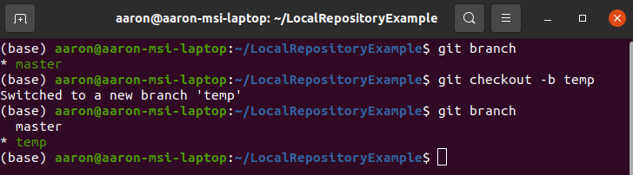
Practicum - Branches and Merges
Going back to our example repository - let’s make a branch
First, list all existing branches by running “git branch”
Next we can create and checkout a new branch by running “git checkout -b <new branch name>”
Finally we can list the branches again
Because we have checked out the new branch, any commits we make will be in the new branch, as soon as we make one commit in either we have divergent branches

Slide 30
Practicum - Branches and Merges
Now, let’s make some more versions in the new branch
Make and commit, in sequence, the following changes as separate commits
In the fourth line of ExampleText.txt type “This line was added in version 4”
Add and commit changes
In the second line of ExampleText.txt type “This line was added in version 5” - do this by pushing subsequent lines down one
Add and commit changes

Slide 31
Practicum - Branches and Merges
Now, let’s make some more versions in the master branch
First, checkout the master/main branch by running “git checkout master” - note that the previous edits disappear!
Make and commit, in sequence, the following changes as separate commits
In the third line of ExampleText.txt type “This line was added in version 4” - do this by pushing subsequent lines down one
Add and commit changes
In the first line of ExampleText.txt type “This line was added in version 5” - do this by pushing subsequent lines down one
Add and commit changes

Slide 32
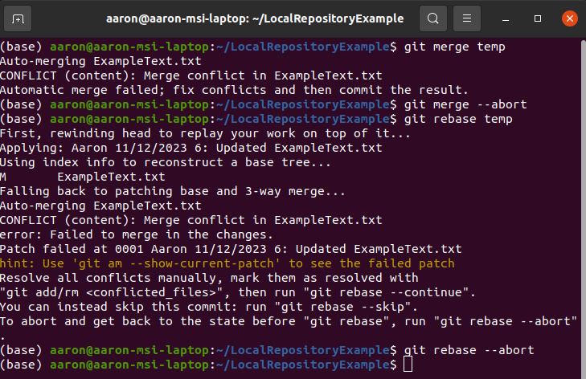
Practicum - Branches and Merges
So, lets try to merge the new branch onto the master/main branch
The command is “git merge <new branch name>” ... and we get a merge conflict. Can you explain why? (rebase also won’t work)

Slide 33
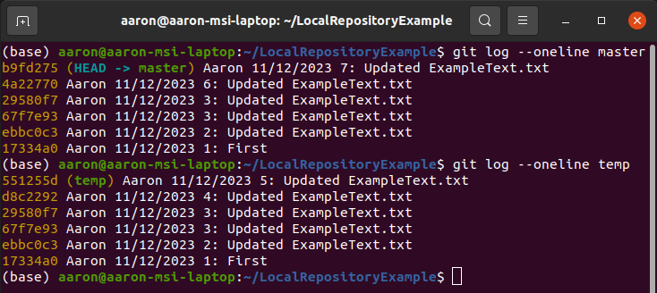
Practicum - Branches and Merges
In order to make that merge work, we’re going to need to roll-back the master/main branch to the common ancestor - lets look at the branch histories to find that
And the answer is commit 67f7e93. We can either reset master/main to 67f7e93 then merge or we can revert master/main to 67f7e93 then rebase

Slide 34
Practicum - Branches and Merges
To reset, checkout the correct branch then use “git reset <commit id>”
To revert, checkout the correct branch then use “git revert <commit id>”
To merge, checkout the correct branch then use “git merge <merge branch>”
To rebase, checkout the correct branch then use “git rebase <merge branch>”
If you reset then you will end up with unstaged changes which will make the merge impossible, if you get theis error:
”error: Your local changes to the following files would be overwritten by merge: ExampleText.txt Please commit your changes or stash them before you merge.”
The easiest thing to do is stash the changes by typing “git stash” then trying the merge
If you do get merge conflicts the first thing to do is abort the merge or rebase, use the --abort option (e.g. git merge --abort)

Slide 35
Section 3: Upstream Repositories

Slide 36
Upstream Repositories - Overview
Anecdotally, when I ask people if they know how to use git, they often respond “like Github?”
Git is a software package, Github and Gitlab are cloud storage companies that allow you to host upstream remote repositories. Github and Gitlab run git
An upstream repository is a version of a repository from which local repositories can be “cloned” and to which local changes can be pushed
Cloning means what it sounds like - when you clone a repository you end up with a local repository which is exactly the same as the upstream

Slide 37
Upstream Repositories - Pushing and Pulling
The workflow between an upstream and local repository is defined by pushes and pulls
The pull (git pull) command pulls the upstream version of a given branch to the local repository
The push (git push) command pushes the local version of a given branch to the upstream respository
Pushes and pulls can fail if the respective branches have been edited - this is a particular problem for repositories with many maintainers
Github Repository
Local Repository

Slide 38


Upstream Repositories - Merge Conflicts
Push/pull issues happen in the following scenario:
Developer 1 pulls Branch A
Developer 2 pulls Branch A
Developer 1 commits changes to branch A
Developer 1 pushes changes to upstream
Developer 2 commits changes to branch A
Developer 2 tries to push ... and gets an error because the two versions of branch A couldn’t be merged
There are a couple good ways to avoid this scenario

Slide 39
Upstream Repositories - Working on Local Branches
If you pull a branch from upstream - don’t directly commit to that branch
Proper workflow is:
Developer 1 pulls Branch A
Developer 1 creates local branch A_Local
Developer 1 commits to A_Local
Developer 1 pulls and rebases A from upstream
Developer 1 checks out A
Developer 1 merges A_Local onto A
Developer 1 pushes A
Developers 2 - N do the same
This gaurantees that any merge conflicts will be local rather than upstream, these can be solved locally without compromising the shared version

Slide 40
Upstream Repositories - Repository Roles
A great feature of upstream repositories is member roles. For now we’ll only talk about maintainers and developers.
Developers are able to push commits to branches other than master/main
Maintainers are able to push commits to all branches including master/main
The logic here is that each developer can be assigned a branch to push changes to then the maintainer can pull these branches, merge them, and update the master/main.
This system works well and I would always recommend having defined roles for teams of greater than about 3.

Slide 41
Upstream Repositories - Modular Code
Finally, it is generally good advise to make code maximally modular with the idea being that no two developers will routinely have to edit the same file or even the same folder. This obviously minimizes merge conflicts

Slide 42
Practicum: Upstream Repositories

Slide 43
Practicum - Upstream Repositories
This practicum will concern the class setting up a github repository in order to finish Vaish’s rock-paper-scissors example from an earlier lecture.
Please everyone make a github account is you don’t have one
Someone set up the repository and invite the others as developers
We will go around the room adding code section by section until the upstream repository has fully functional code. The code on the master/main should always execute without errors.
To pull - git pull <branch> if no branch is specified it will pull master/main. good idea to specify rebase rather than merge (git pull --rebase)
Then:
make a local branch
add changes
commit changes
re-pull the upstream
merge or rebase the local onto the upstream
push

